Slide 1


OBJECTIVE
To introduce the NUDGE theory as a framework to look at the task of influencing peoples’ decisions. To introduce the concept of choice architecture.
TOOL
NUDGE THEORY
THE FINLAB TOOLKIT

Slide 2
ABOUT ‘STARTUP CANVAS’
The NUDGE framework is a set of principles that help design/architect the choices that people make by organising the context in which people make decisions. The framework emerges from the world of behavioural economics which proposes that rational decision making is an ideal and rare occurrence, and most people need aids to help them make the right choices.
THE FINLAB TOOLKIT

Slide 3
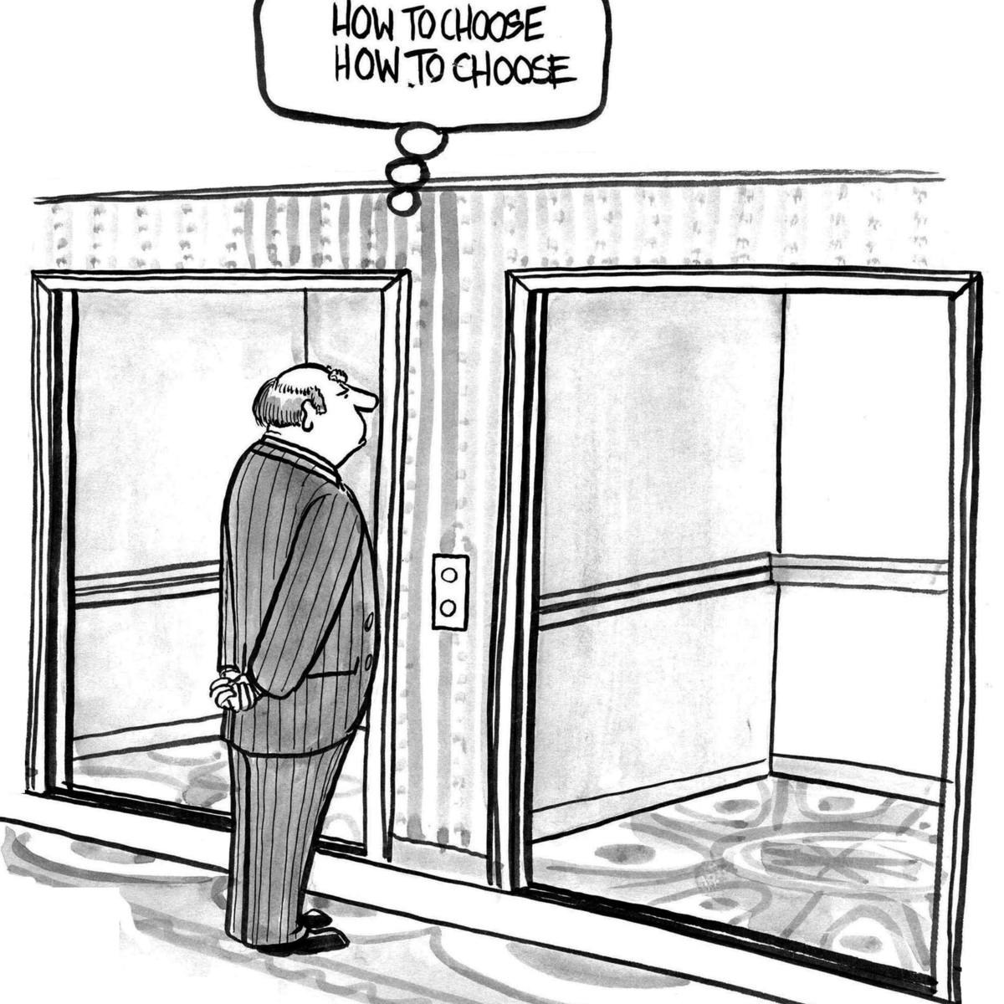
THE FINLAB TOOLKIT

Slide 4
Cases when Nudges are powerful
Benefits Vs. Costs: When people have multiple choices and do not fully appreciate the true costs and benefits of their actions. They often choose short term benefit and long term cost which is not ideal.
Degree of Difficulty: When people struggle with genuinely complex choices that require a high degree of reflection, fact finding, analysis etc. so that they can make an informed choice.
Rare Choices: When people have to make decisions that are rare in nature and they are not quite able to depend on their own experiences to make a choice.
Feedback: When people can benefit from input/information about their current choices because in the absence of it self learning may be chance based or never happen.
Knowing What You Like: When people are confused about what the benefits from different choices actually mean for them, and are unable to predict how their choices will affect their life.
THE FINLAB TOOLKIT

Slide 5
NUDGES
Give iNcentives
What could be ‘incentives’ offered to affect the desired behaviour?
Who is the user? Who chooses? Who pays? Who profits?
These could be real rewards or costs. These could also be social rewards.
THE FINLAB TOOLKIT

Slide 6
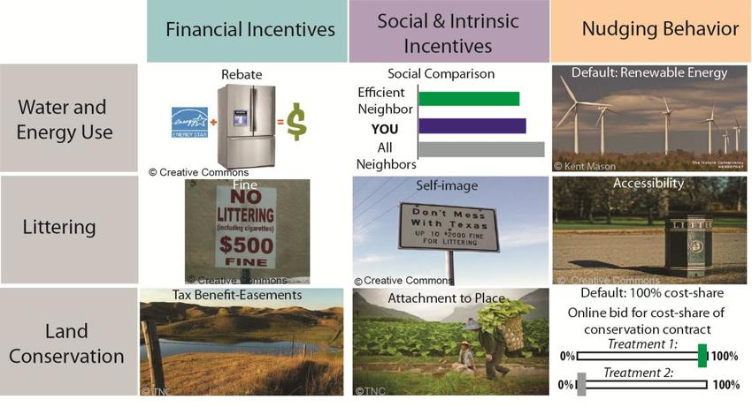
THE FINLAB TOOLKIT

Slide 7
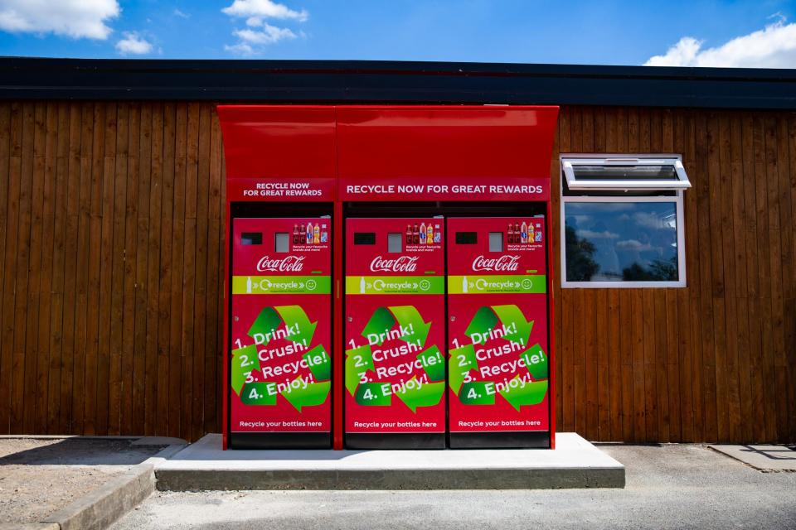
THE FINLAB TOOLKIT

Slide 8
A commercial bank in the Philippines offered a savings product called SEED (Save, Earn, Enjoy Deposits) that prevented clients from accessing their funds until they reached a certain goal—either an amount or time period, decided by the client. Around one in three people offered the account opted to open one, and one in nine made regular deposits. A year after the offers went out, clients offered the accounts had increased their account balances 80 percent more than those with normal accounts.
THE FINLAB TOOLKIT

Slide 9
NUDGES
Understand Mappings
How do we proactively inform users so they ‘Understand’ the cost(s)-benefit(s) of choices before them?
What are the choices available? What are cost-benefits for each?
How can the choices be compared?
THE FINLAB TOOLKIT

Slide 10
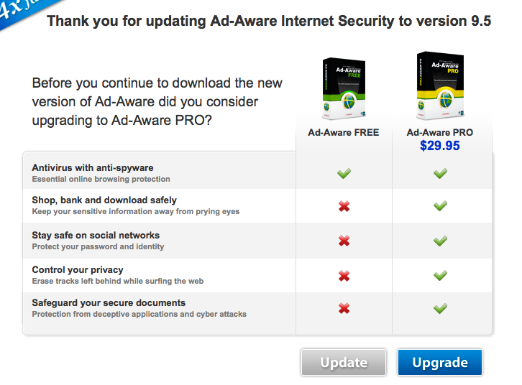
THE FINLAB TOOLKIT

Slide 11
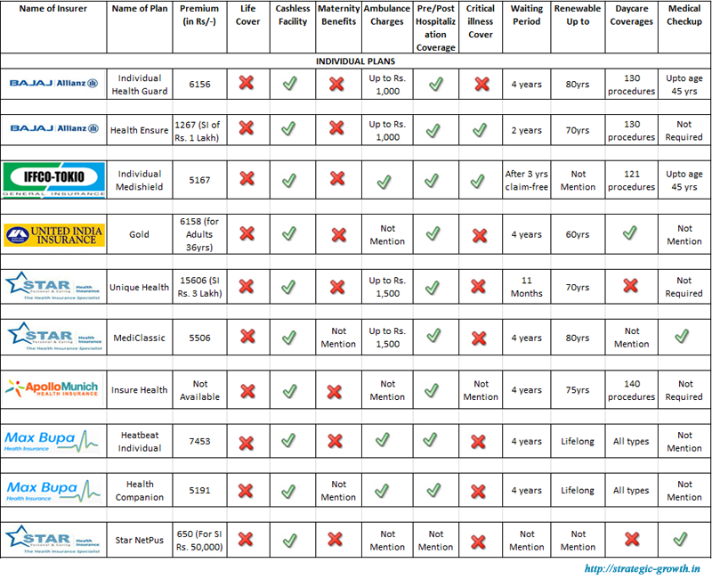
THE FINLAB TOOLKIT

Slide 12
NUDGE
Set Defaults
What is the ‘default’ setting that is the closest to the desired choice we want users to make?
Which choice is recommended for greatest user benefit?
Which choice is recommended for the broader goal?
What can users opt out of and opt into?
THE FINLAB TOOLKIT

Slide 13
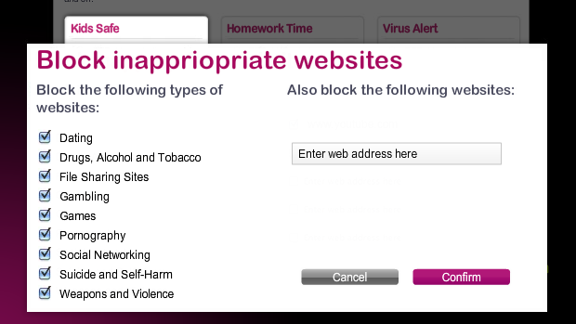
THE FINLAB TOOLKIT

Slide 14
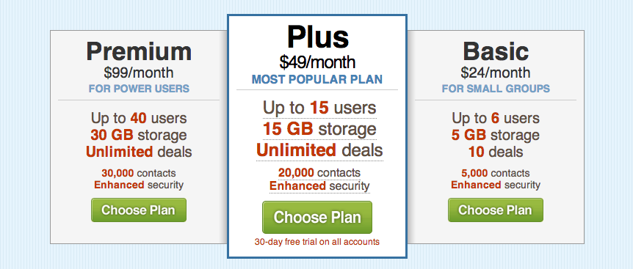
THE FINLAB TOOLKIT

Slide 15
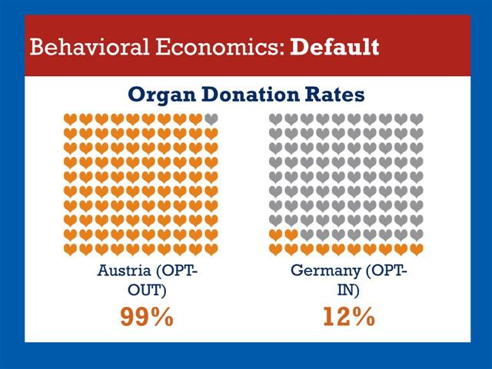
THE FINLAB TOOLKIT

Slide 16
NUDGES
Give Feedback
How do we ‘give feedback’ to users when they are doing well and when they are making mistakes?
When and where do users need feedback?
How do we give negative and positive feedback?
What is the best method to give feedback?
THE FINLAB TOOLKIT

Slide 17
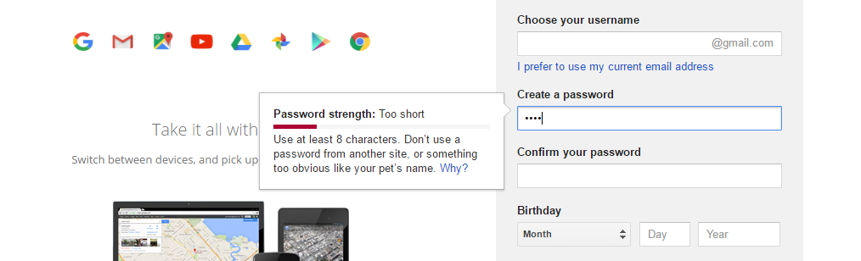
THE FINLAB TOOLKIT

Slide 18
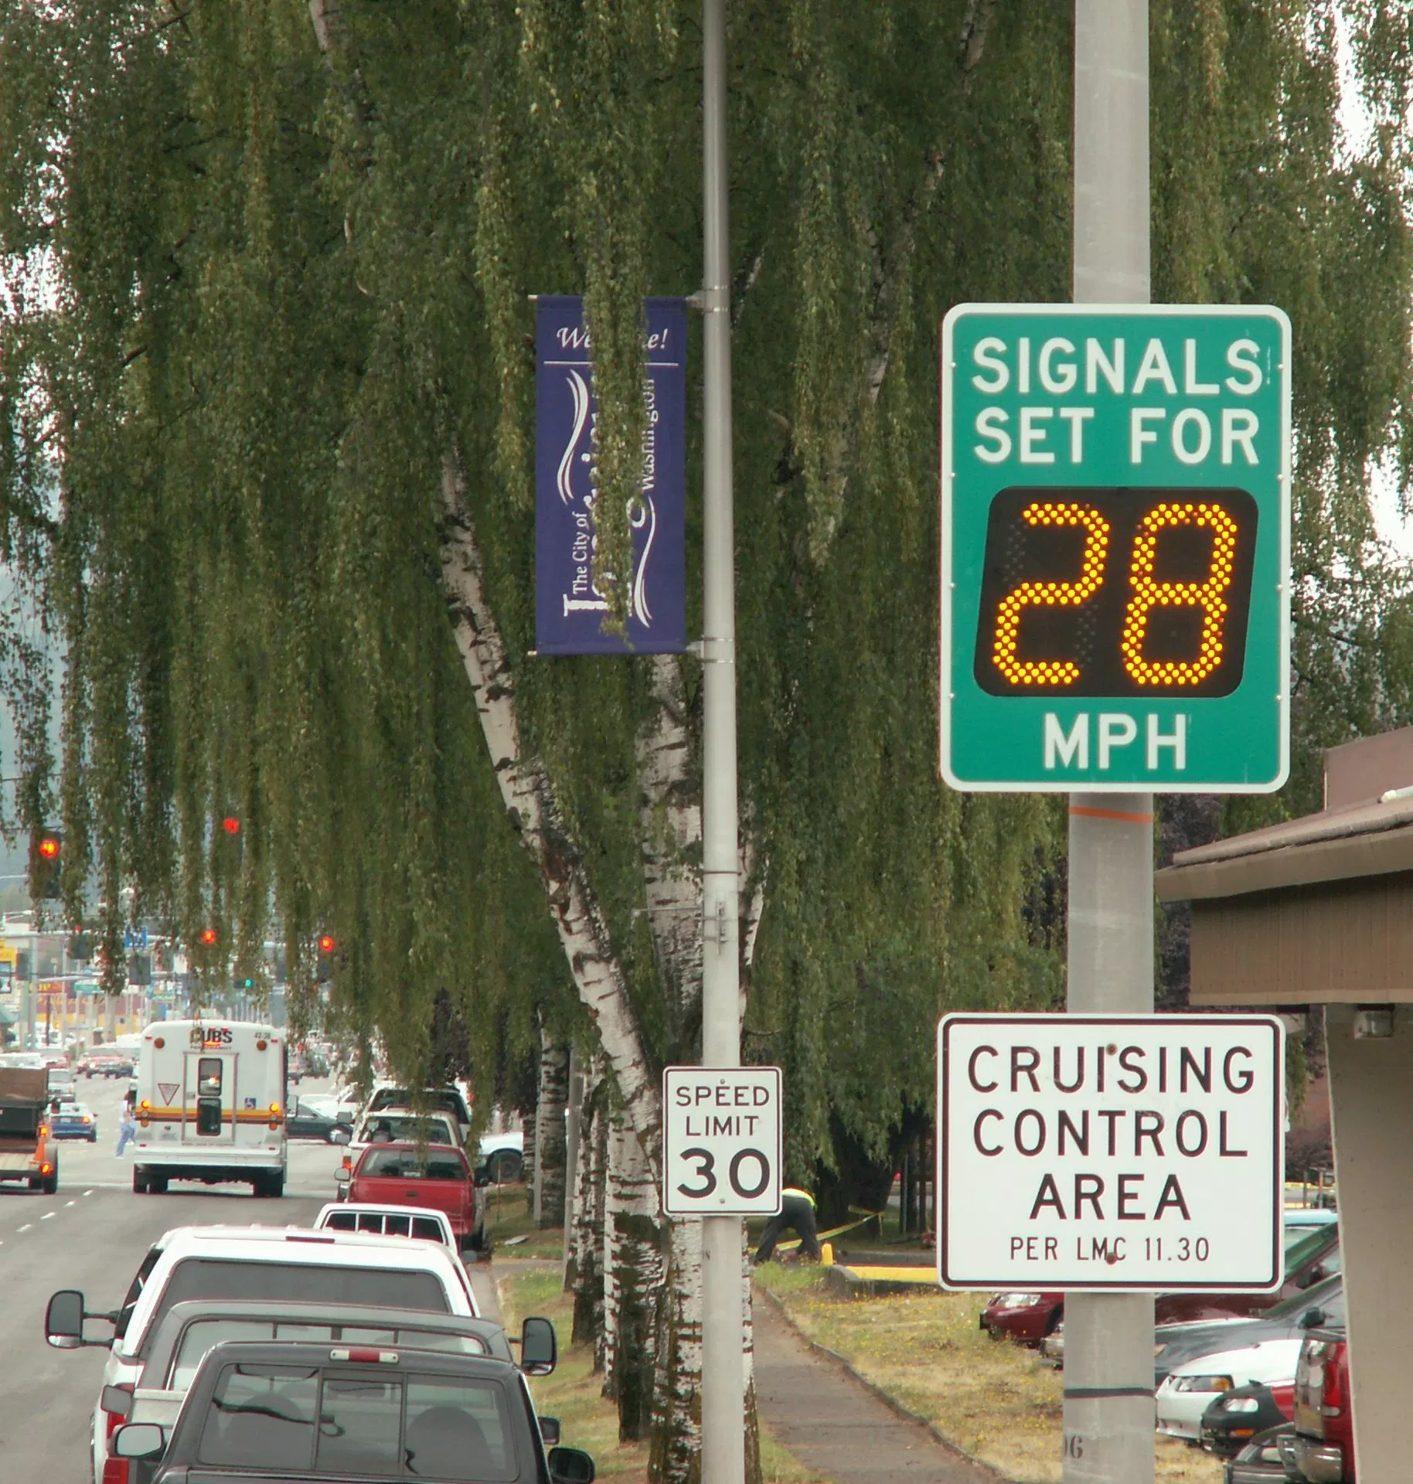
THE FINLAB TOOLKIT

Slide 19
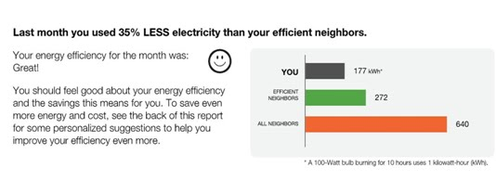
THE FINLAB TOOLKIT

Slide 20
NUDGES
Expect Error
How can we accommodate and forgive ‘expected errors’ that users tend to make?
What are errors that we can expect users to make?
How do we make it work with these errors?
THE FINLAB TOOLKIT

Slide 21
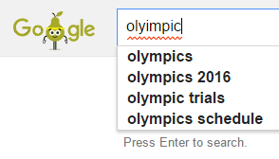
THE FINLAB TOOLKIT

Slide 22
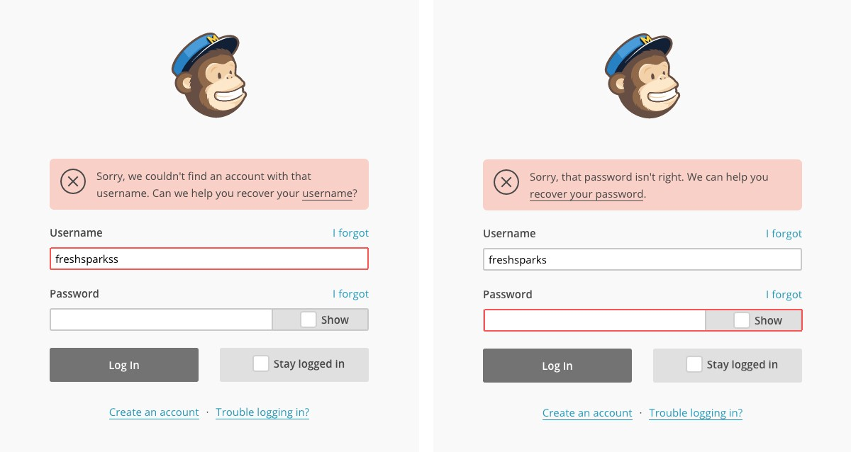
THE FINLAB TOOLKIT

Slide 23
NUDGES
Structure Choices
How do we ‘structure complex choices’ in order to aid decision making?
How do we reduce the number of choices?
How do we visibly simplify?
THE FINLAB TOOLKIT

Slide 24
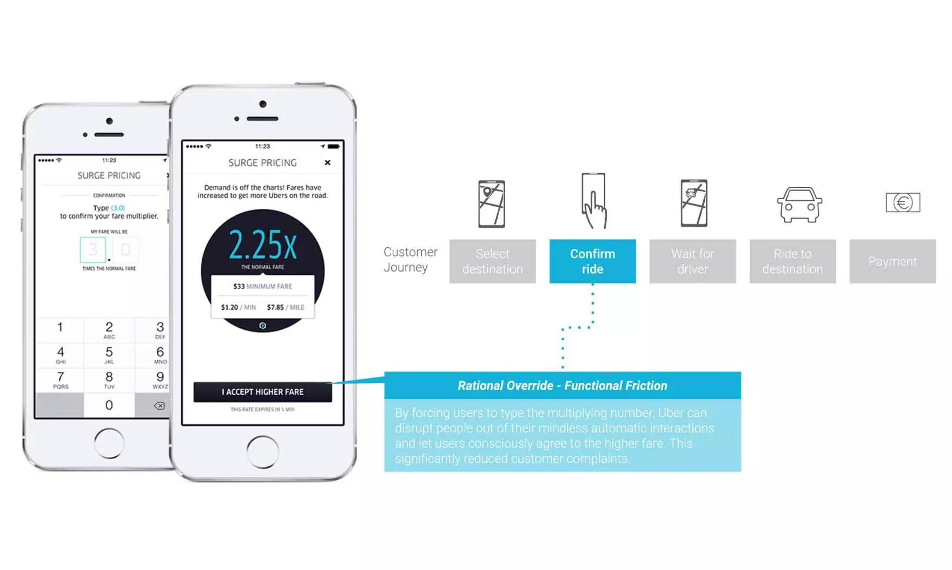
THE FINLAB TOOLKIT

Slide 25

THE FINLAB TOOLKIT

Slide 26
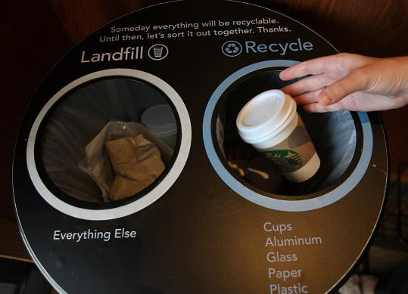
THE FINLAB TOOLKIT

Slide 27

THE FINLAB TOOLKIT

Slide 28
HOW TO USE?
User Profile & Needs | Current Choice & Challenge
 | Desired Choice for Users
(N) What could be ‘incentives’ offered to affect the desired behaviour? (Who is the user? Who chooses? Who pays? Who profits?)
(U) How do we proactively inform users so they ‘Understand’ the cost(s)-benefit(s) of choices before them? (What are the choices available? What are cost-benefits for each?)
(D) What is the ‘default’ setting that is the closest to the desired choice we want users to make? (What is the default setting that is best for the user?)
(G) How do we ‘give feedback’ to users when they are doing well and when they are making mistakes? (Where do users need feedback? Should it be verbal or physical?)
(E) What can we accommodate and forgive ‘expected errors’ that users tend to make? (What are errors to expect? How do we make it work with these errors?)
(S) How do we ‘structure complex choices’ in order to aid decision making? (How do we reduce the number of choices? How do we visibly simplify?)
1
2
3
User Profile & Needs
Note down: The user’s profile and needs for which choice needs to be facilitated.
Current & Desired Choice
Note down: The current choices being made and issue with them. Also, the ideal choice that user should be making.
NUDGES
Note down: Ideas on what one could do to facilitate choices using the NUDGE framework.
THE FINLAB TOOLKIT

